Slide 1
DIGITAL – ANALOG CONVERTERS
Many voltages and currents vary continuously over some range of values. The signals are either one of two levels, representing the binary values of 1 or 0.
An analog to digital converter (ADC) obtains a digital value representing an input analog voltage, while a digital to analog converter (DAC) changes a digital value back into an analog voltage.

Slide 2
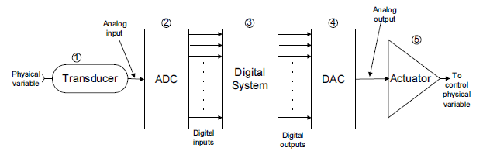
ADC and DAC interface

Slide 3
Transducer
A device that converts the physical variable to an electrical variable. The electrical output of the transducer is an analog current or voltage that is proportional to the physical variable it is monitoring. Some common transducers: thermistors, photocells, photo diodes, flow meters, pressure transducers, and tachometers.

Slide 4
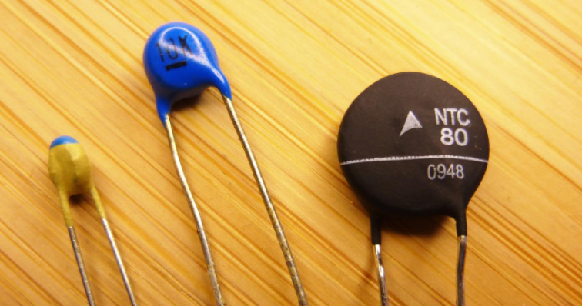

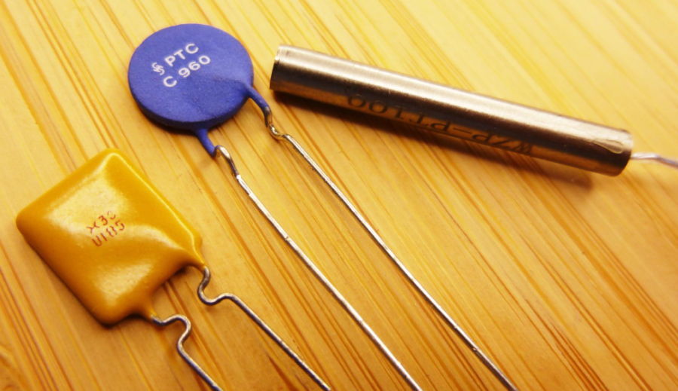
THERMISTOR

Slide 5
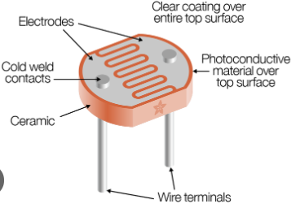
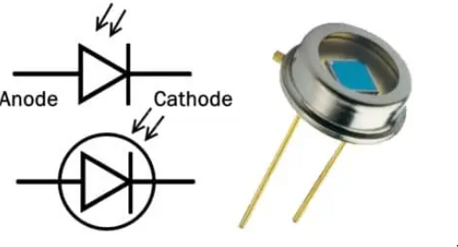
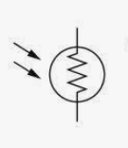
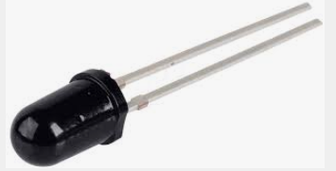
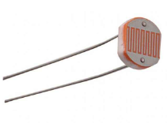
PHOTOCELL & PHOTO DIODES
PHOTOCELL PHOTO DIODES

Slide 6
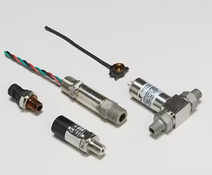
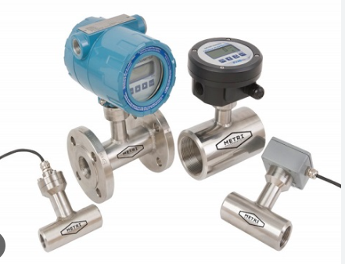
FLOW METERS & PRESSURE TRANSDUCERS
FLOW METERS PRESSURE TRANSDUCERS

Slide 7
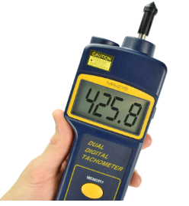
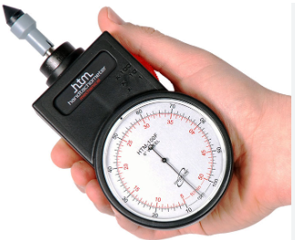
TACHOMETERS

Slide 8
Analog to Digital Converter (ADC)
The transducer’s electrical analog output serves as the analog input to the ADC. The ADC converts this analog input to a digital output. This digital output consists of a number of bits that represent the value of the analog input.

Slide 9
Digital System
The digital representation of the process variable is transmitted from the ADC to the digital computer, which stores the digital value and processes it according to a program of instructions that it is executing. The program might perform calculations or other operations on this digital representation.

Slide 10
Digital to Analog Converter (DAC)
This digital output from the computer is connected to a DAC, which converts it to a proportional analog voltage or current.

Slide 11
Actuator
The analog signal from the DAC is often connected to some device or circuit that serves as an actuator to control the physical variable.
A device that causes a machine or other device to operate.

Slide 12
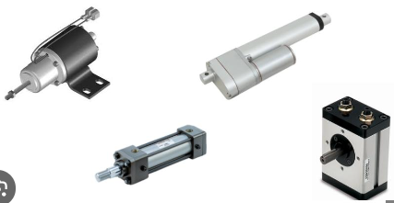
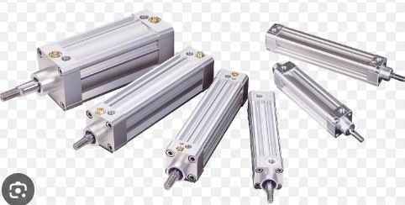

ACTUATORS

Slide 13
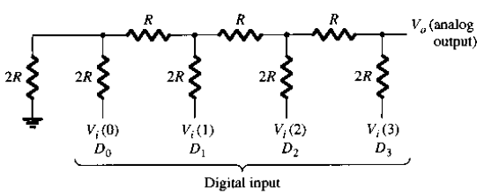
Digital to Analog Conversion
Ladder Network Conversion
A ladder network accepts inputs of binary values at, typically, 0 V or Vref and provides an output voltage proportional to the binary input value.

Slide 14

Ladder Network Conversion
A ladder network with four input voltages, representing 4 bits of digital data and a dc voltage output. The output voltage is proportional to the digital input value as given by

Slide 15
The function of the ladder network is to convert the 16 possible binary values from 0000 to 1111 into one of 16 voltage levels in steps of Vref/16. Using more sections of ladder allows having more binary inputs and greater quantization for each step. For example, a 10-stage ladder network could extend the number of voltage steps or the voltage resolution to Vref/2¹⁰ or Vref/1024. A reference voltage of

Slide 16

Vref = 10 V would then provide output voltage steps of 10 V/1024 or approximately 10 mV. More ladder stages provide greater voltage resolution. In general, the voltage resolution for n ladder stages is

Slide 17
The digital inputs D0, D1, D2, and D3 are usually derived from the output register of a digital system. The 2⁴ = 16 different binary numbers represented by these 4 bits for each input number, the D/A converter output voltage is a unique value. In this case, the analog output voltage Vo is equal in volts to the binary number.

Slide 18
In general,
Analog output = K × digital input
where K is the proportionality factor and it is constant value for a given DAC. The analog output can be a voltage or current. When it is a voltage, K will be in voltage units, and when the output is current, K will be in current units.

Slide 19
For the DAC of K = 1 V, so that
Vo = (1 V) × digital input
We can use this to calculate Vo for any value of digital input.
Example, with a digital input of 11002 = 1210, we obtain
Vo = 1V × 12 = 12V

Slide 20
Example
For a 5-bit DAC digital input of 10100, an output current of 10mA is produced. What will Io be for a digital input of 11101?
What is the largest value of output voltage from an 8-bit DAC that produces 1.0V for a digital input of 00110010?

Slide 21
Solution
Convert 101002 to 2010 & 111012 to 2910
find K and Io
Analog output = K × digital input
10mA = K x 20
K = 0.5 mA
Io = 0.5 mA × 29
Io = 14.5 mA

Slide 22
Solution
2. Convert 001100102 to 5010
find K and Vo
Analog output = K × digital input
1 V = K x 50
K = 20 mV
The largest output will be 111111112 = 25510
Vo (max) = 20 mV x 255
Vo (max) = 5.1 V

Slide 23

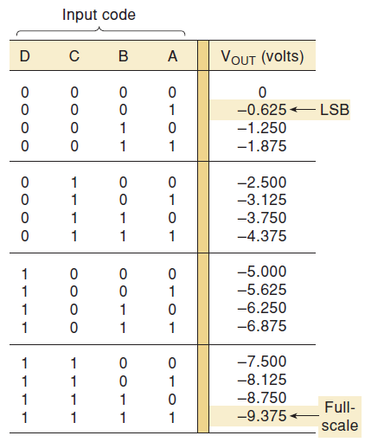
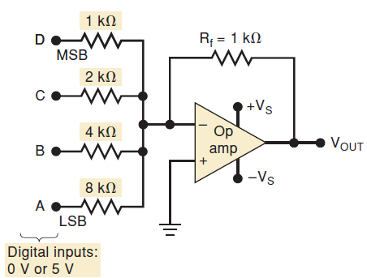
DAC CIRCUITRY
Basic circuit for four-bit
DAC employing an op amp
as a summing amplifier.

Slide 24
Analog to Digital Conversion
An analog to digital converter takes an analog input voltage and, after a certain amount of time, produces a digital output code that represents the analog input. The A/D conversion process is generally more complex and time consuming than the D/A process, and many different methods have been developed and used.

Slide 25
Analog to Digital Conversion
Several important types of ADCs utilize a DAC as part of their circuitry. The timing for the operation is provided by the input clock signal. The control unit contains the logic circuitry for generating the proper sequence of operations in response to the start command, which initiates the conversion process.

Slide 26
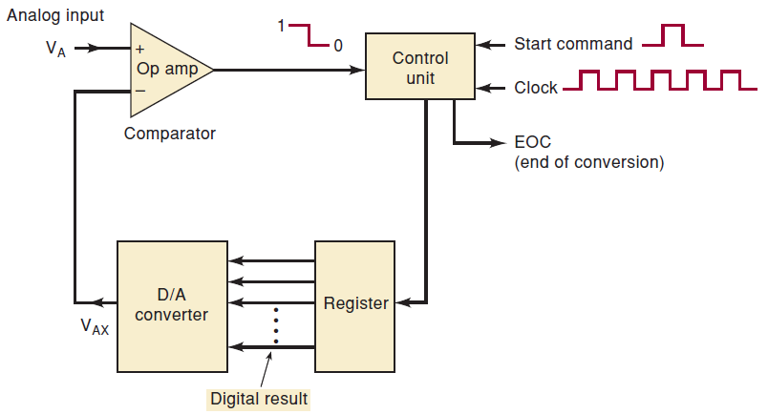
Analog to Digital Conversion
The op-amp comparator has two analog inputs and a digital output that switches states, depending on which analog input is greater.

Slide 27
The basic operation of ADCs of this type consists of the following steps:
1. The start command pulse initiates the operation.
2. At a rate determined by the clock, the control unit continually modifies the binary number that is stored in the register.
3. The binary number in the register is converted to an analog voltage, VAX, by the DAC.

Slide 28
4. The comparator compares VAX with the analog input VA. As long as the comparator output stays HIGH. When VAX exceeds VA by at least an amount equal to VT (threshold voltage), the comparator output goes LOW and stops the process of modifying the register number. At this point, VAX is a close approximation to VA. The digital number in the register, which is the digital equivalent of

Slide 29
VAX, is also the approximate digital equivalent of VA, within the resolution and accuracy of the system.
5. The control logic activates the end of conversion signal, EOC, when the conversion is complete.

Slide 30
Digital-Ramp ADC
It is one of the simplest versions of the general ADC using a binary counter as the register and allows the clock to increment the counter one step at a time until VAX ≥ VA. It is called a digital-ramp ADC because the wave form at VAX is a step-by-step ramp or a staircase. It is also referred to as a counter-type ADC.

Slide 31
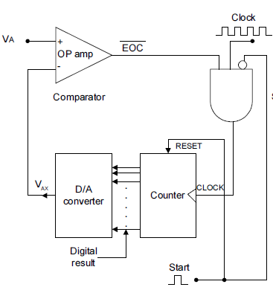
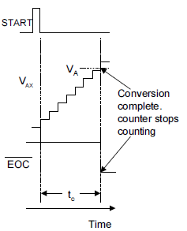
Digital ramp ADC

Slide 32
Digital-Ramp ADC
It contains a counter, a DAC, an analog comparator, and a control AND gate. The comparator output serves as the active-LOW end-of-conversion signal, $\overline{EOC}$.
If we assume that VA, the analog voltage to be converted, is positive, the operation proceeds as follows:

Slide 33
1. A START pulse is applied to reset the counter to zero. The HIGH at START also inhibits clock pulse form passing through the AND gate into the counter.
2. With all 0’s at its input, the DAC’s output will be VAX = 0V.
3. Since VA > VAX, the comparator output, $\overline{EOC}$, will be HIGH.

Slide 34
4. When START returns LOW, the AND gate is enabled and clock pulses get through to the counter.
5. As the counter advances, the DAC output, VAX, increases one step at a time.
6. This continues unit VAX reaches a step that exceeds VA by an amount equal to or greater than VT (typically 10 to 100 μV). At this point,

Slide 35
$\overline{EOC}$will go LOW and inhibit the flow of pulses into the counter and the counter will stop counting.
7. The conversion process is now complete as signaled by the HIGH-to-LOW transition at $\overline{EOC}$, and the contents of the counter are the digital representation of VA.
8. The counter will hold the digital value until the next START pulse initiates a new conversion.

Slide 36
Assume the following values for the digital ramp ADC of : clock frequency = 1 MHz; VT = 0.1 mV; DAC has full scale output = 10.23 V and a 10-bit input.
Determine the following values:
a) The digital equivalent obtained for VA=3.728 V
b) The conversion time
c) The resolution of this converter

Slide 37
The DAC has a 10-bit input and a 10.23-V F.S. output. Thus, the number of total possible steps is $2^{n}−1$and so the step size is
$\# of steps= 2^{10}−1$ = 1023
step size = $\frac{10.23 V}{1023}$ = 10 mV
VAX increases in steps of 10 mV as the counter counts up from 0.

Slide 38
Since VA is 3.728 V and VT is 0.1 mV, VAX must reach 3.7281 V or more before the comparator switches LOW. This will require
$\# of steps= \frac{3.7281 V}{10 mV}=372.81=373 steps$
At the end of the conversion, the counter will hold the binary equivalent of 373, which is 0101110101, the desired digital equivalent of
VA = 3.728 V, as produced by this ADC.

Slide 39
b) Conversion time = # of steps x time
Conversion time = (373)(1/1MHz)
Conversion time = 373 μs
c) Resolution = step size of the DAC in %
Resolution = $\frac{1}{1023}$ x 100%
Resolution = 0.1%

